Slide 1
Overview: Digital Forensic Tools

Slide 2

Objective
By the end of this module, participants will be able to use basic features of a forensic tool to examine digital evidence
Notes:
No single tool that solves every problem.
https://binaryforay.blogspot.com/2016/09/let-benchmarks-hit-floor-autopsy-vs.html

Slide 3


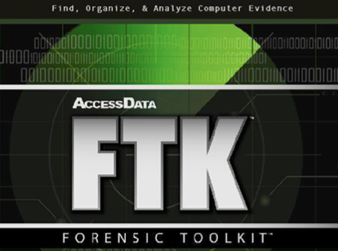
Software: Digital Forensic Tool
Enables searches within image files
Streamlines investigations
Includes:
EnCase by Guidance Software
Forensic Toolkit (FTK) by Access Data
Autopsy Open Source
Notes:
Sleuth Kit forensic tool
Basis Technology Corp. – Largely maintain the Autopsy with the help of programmers throughout the community.

Slide 4
EnCase
Guidance Software

Slide 5
Introduction to EnCase
Digital data acquisition tool that enables:
Email and file system analysis
Remote imaging and investigations
Advanced searches
Remote previewing
Malicious code discovery

Slide 6
Introduction to EnCase
Step Action, you will work individually to:
Install and configure EnCase
Examine evidence files
Sort files
Create bookmarks
Generate report
Notes:
EnCase Demonstration:

Slide 7
Forensic Tool Kit (FTK)
Access Data

Slide 8
Introduction to FTK
Digital data acquisition tool that:
Is similar to EnCase in overall features
Uses a different approach to data storage and terminology
Notes:
Hash Library – KFF Library – National Software Reference Library (NSRL)
File Carver – Data carving
Use third party database: - User accounts and activities
- Oracle
- PostgreSQL – “post-gress-Q-L”
Microsoft SQL

Slide 9
Introduction to FTK
The facilitators will demonstrate how to
Log in to the database
Create a new case
Manage evidence
Refine results
Generate a report
Notes:
Hash Library – KFF Library – National Software Reference Library (NSRL)
File Carver – Data carving
Use third party database: - User accounts and activities
- Oracle
- PostgreSQL – “post-gress-Q-L”
Microsoft SQL

Slide 10
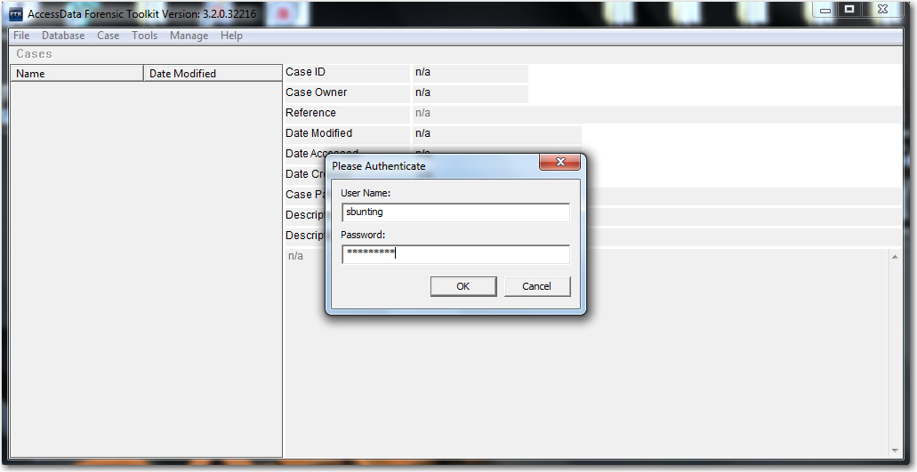
Log in to Database

Slide 11
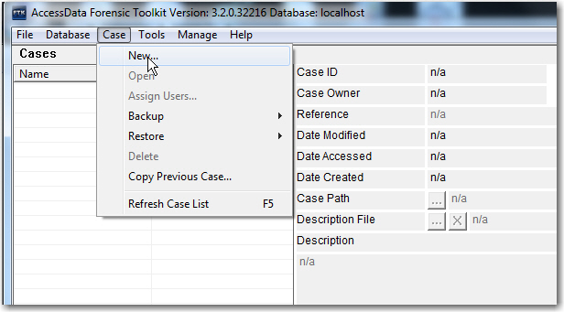
Create a
New Case

Slide 12
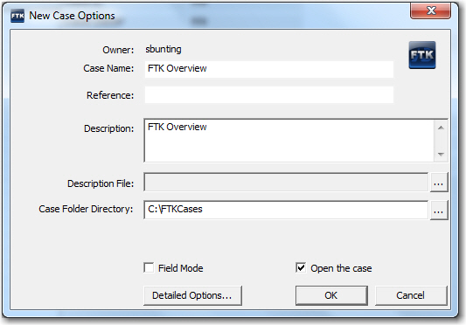
New Case
Options

Slide 13
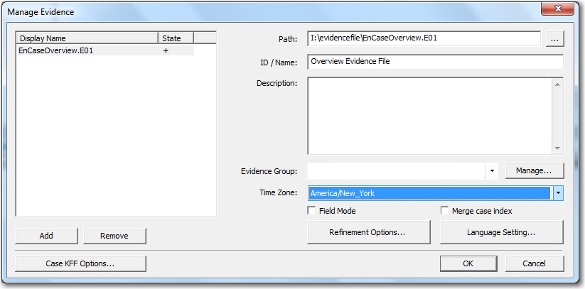
Manage
Evidence

Slide 14
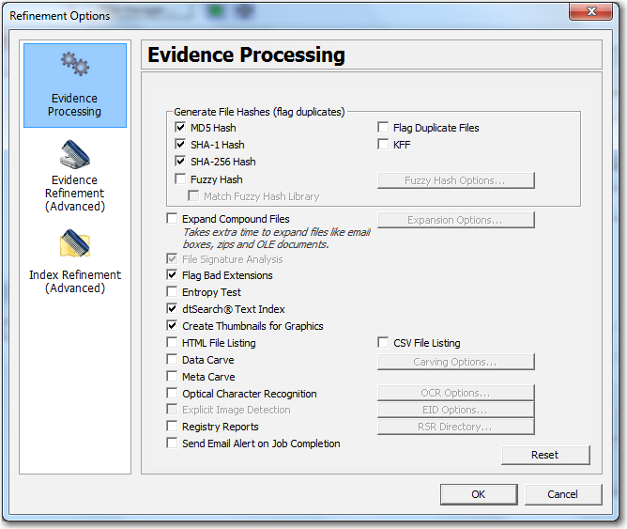
Refinement
Options
Notes:
Fuzzy Hash – Vague or indistinct or not clear
Entropy – lack of order or predictability
OLE – Object Linking and Embedding

Slide 15
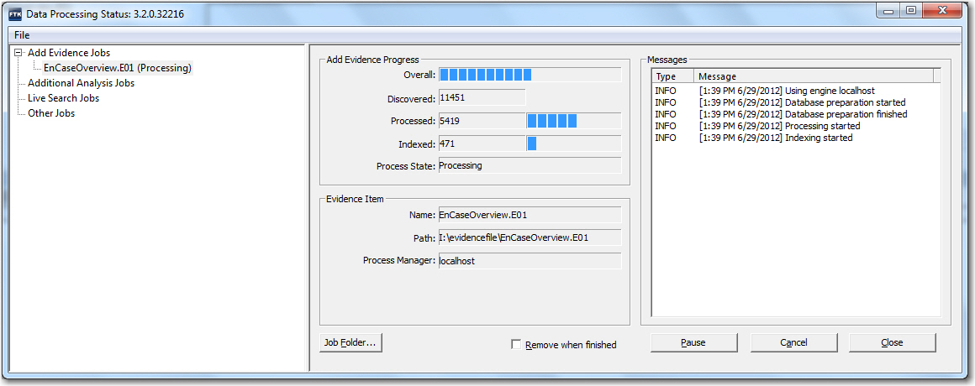
Data Processing
Status

Slide 16
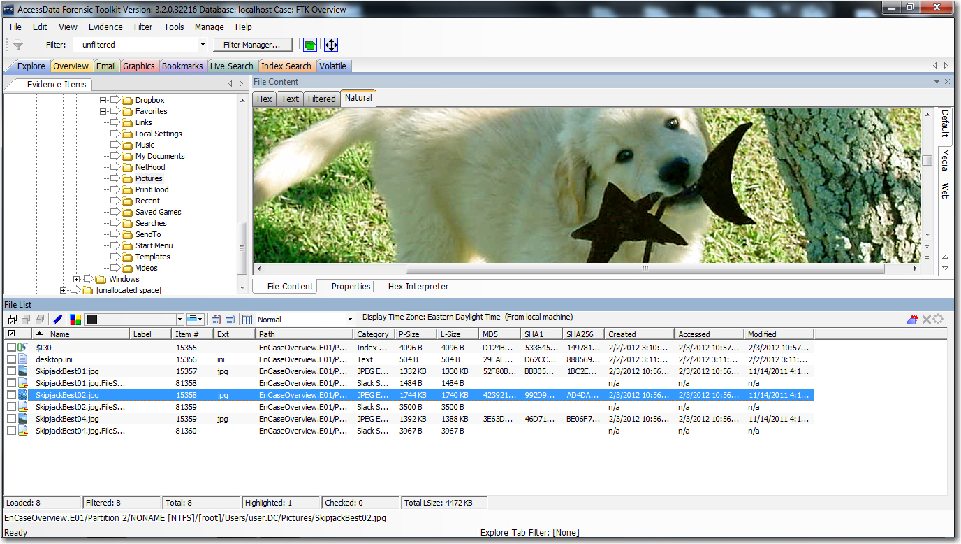
FTK
Explore Tab

Slide 17
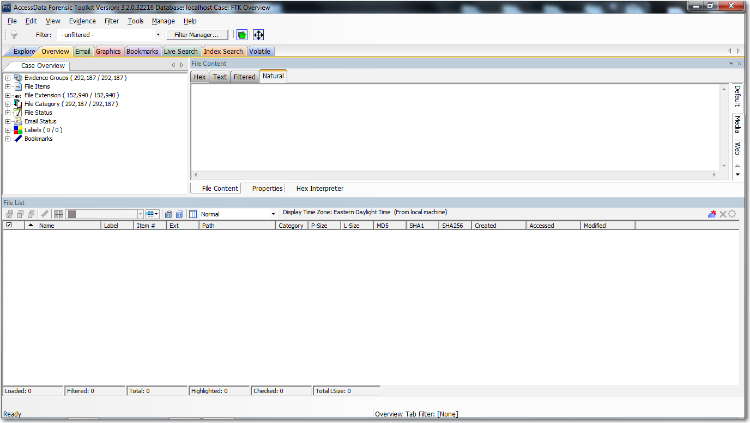
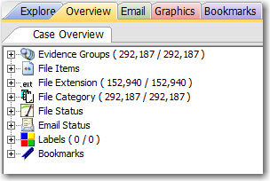
FTK
Overview Tab

Slide 18
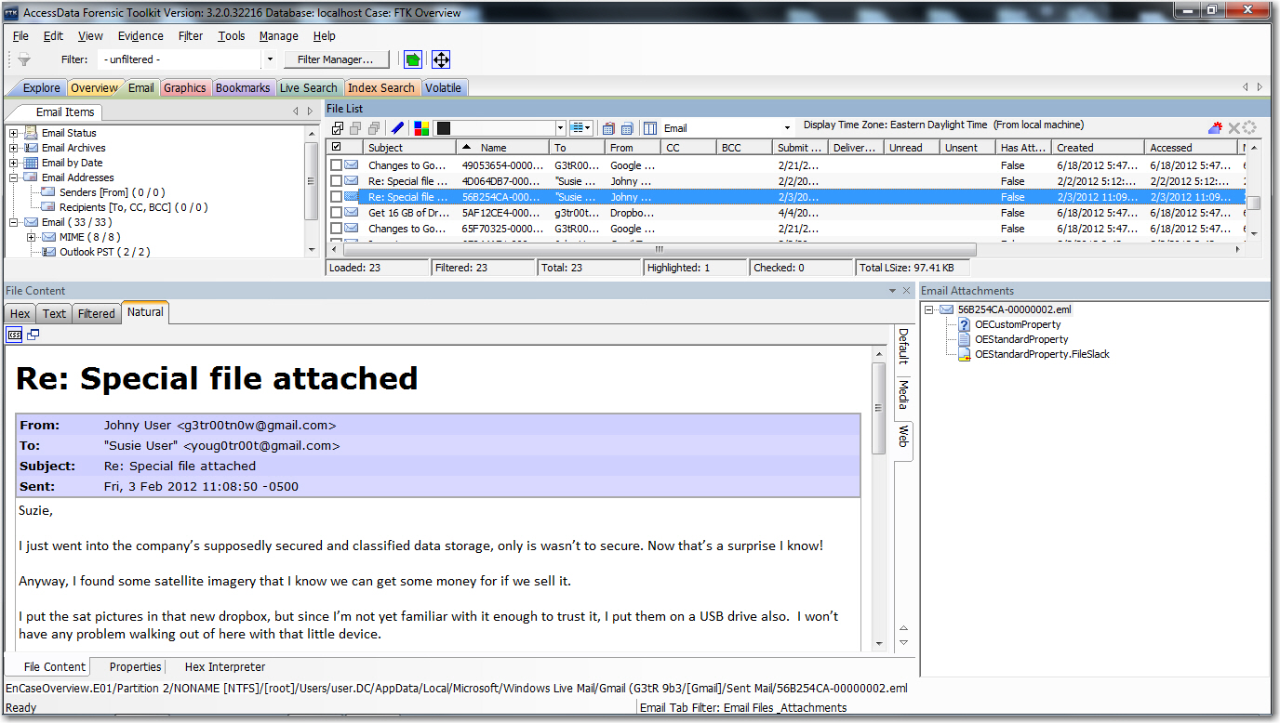
FTK
Email Tab

Slide 19
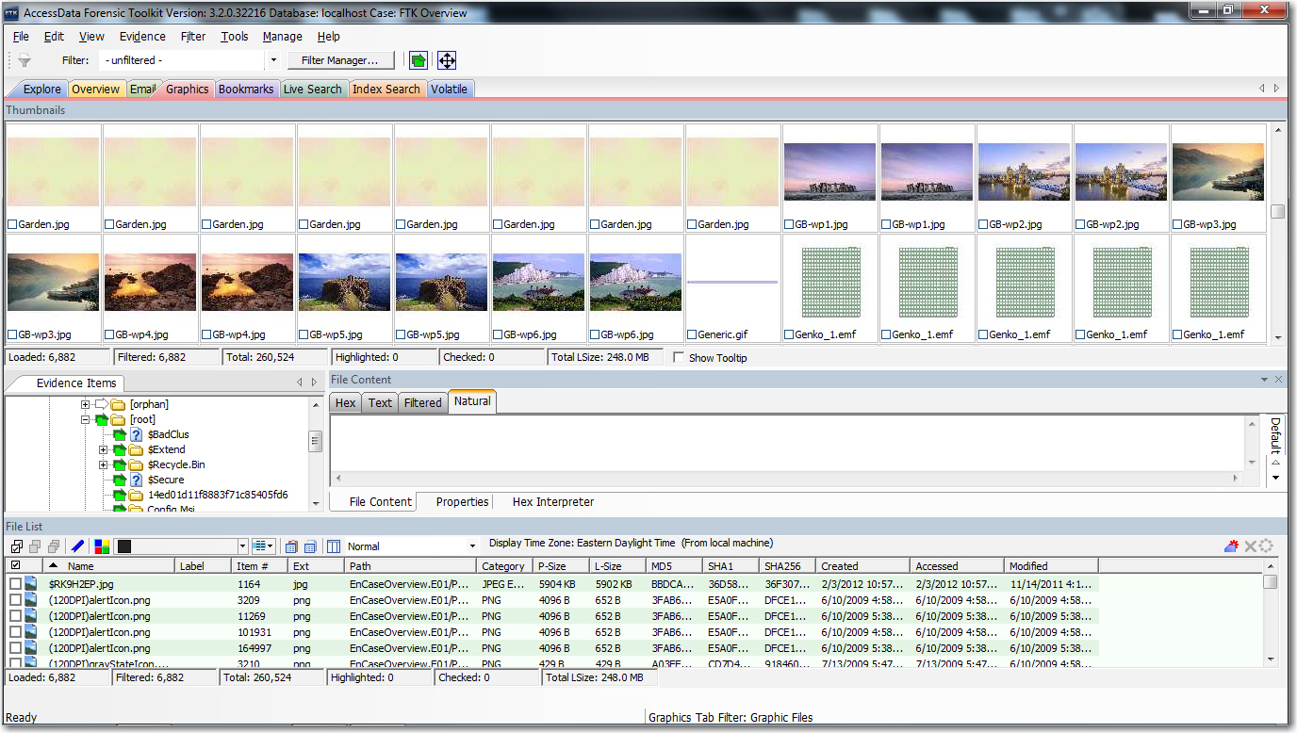
FTK
Graphics Tab

Slide 20
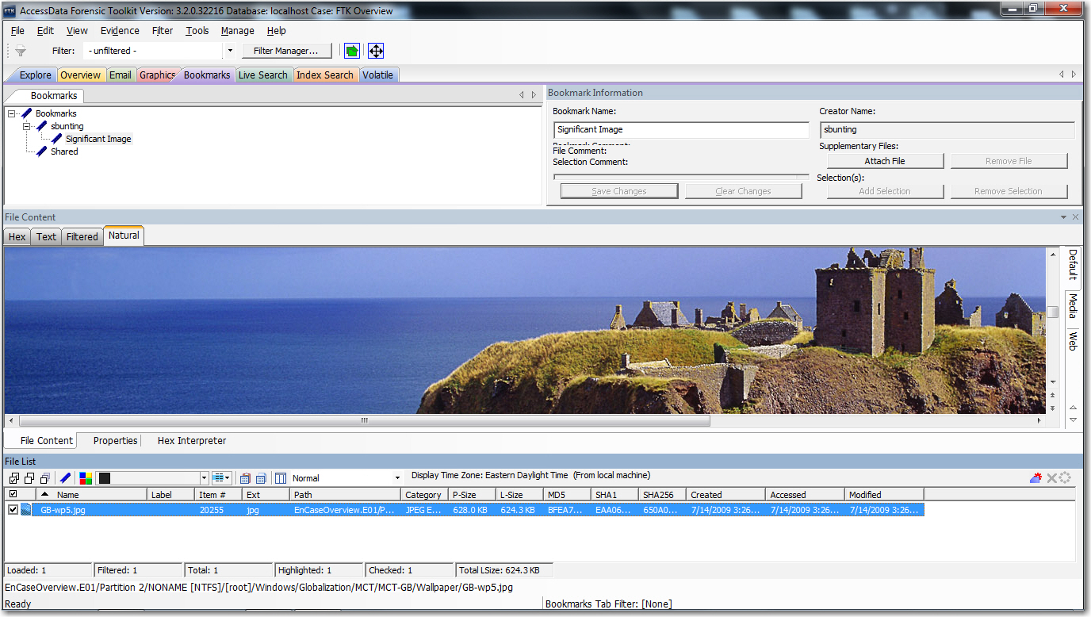
FTK
Bookmarks Tab

Slide 21
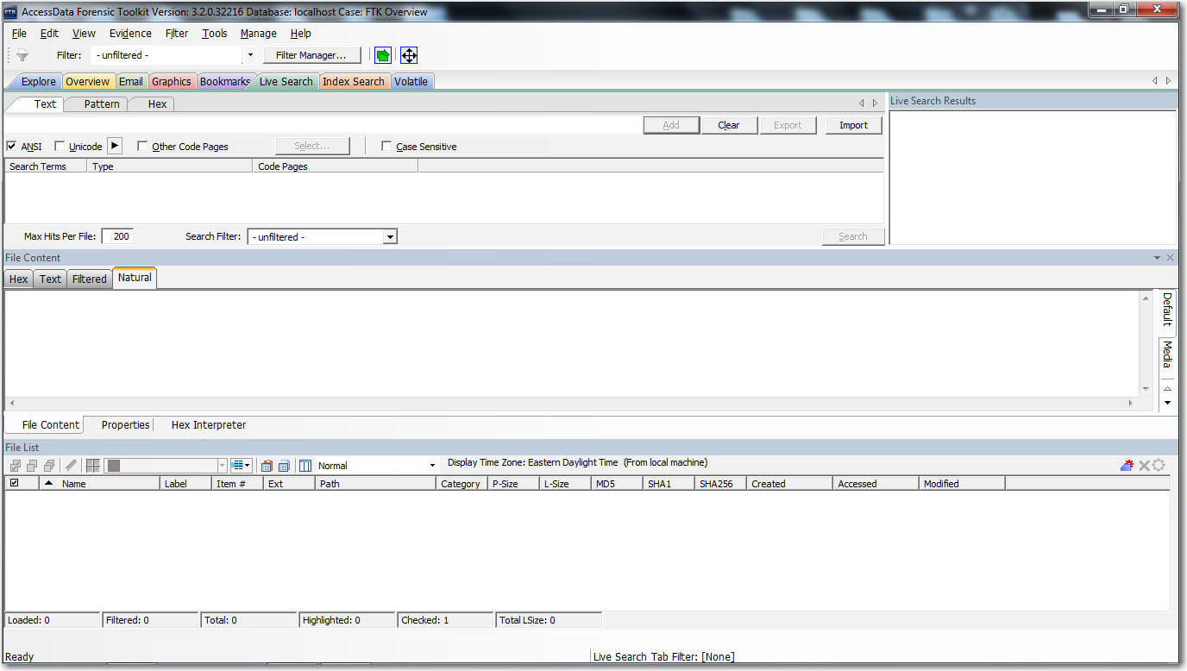
FTK
Live Search Tab

Slide 22
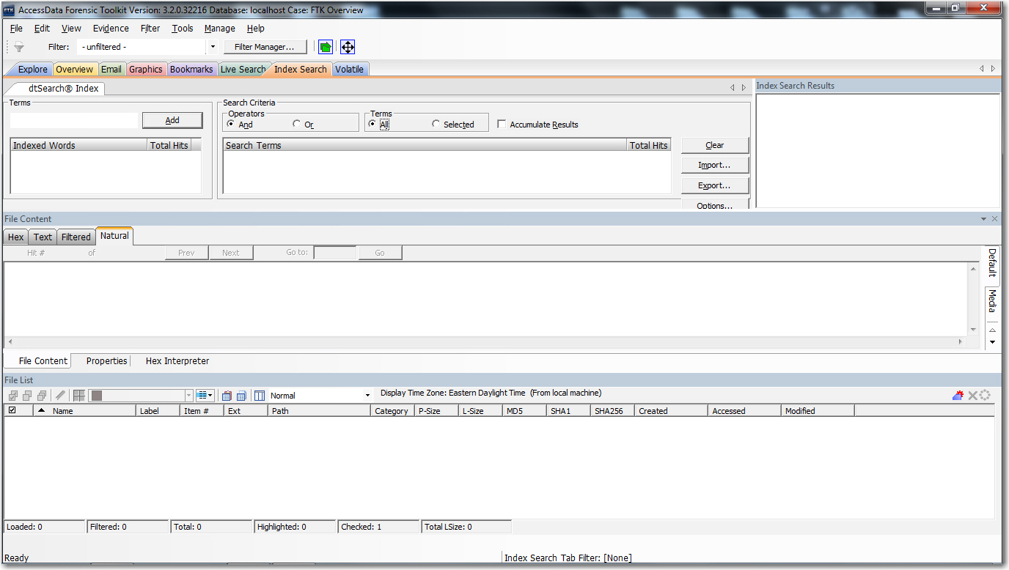
FTK
Index Search Tab

Slide 23
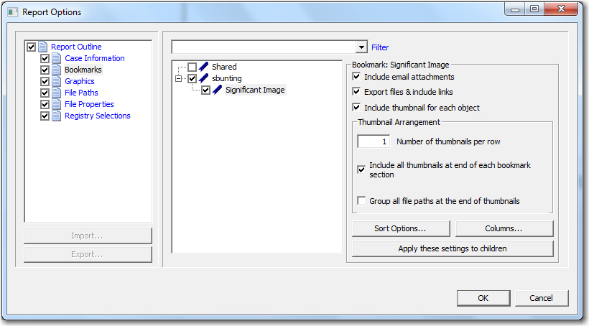
Report
Options

Slide 24
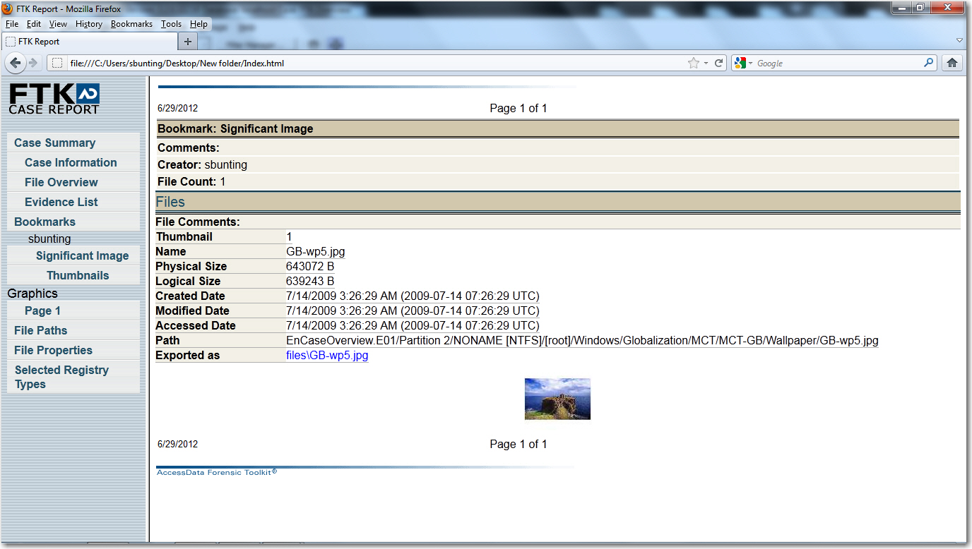
The
Report

Slide 25
Autopsy
Open Source

Slide 26
Introduction to Autopsy
Digital data acquisition tool that:
Is also similar to EnCase in overall features
Email and file system analysis
Advanced searches
File type identification
Data carving

Slide 27
Introduction to Autopsy
Step Action, you will work individually to:
Install Autopsy
Create new case
Examine evidence files
Sort files
Create bookmarks
Generate reports

Slide 28

What forensic tool features would most benefit my investigations?

Slide 29
Summary
You should now be familiar with using forensic tools to:
Create a case
Add and verify evidence
Adjust time zone offsets
Process, navigate through, and bookmark evidence
Create reports from your findings
Notes:
GREP – Globally search for a regular expression and print

Slide 30
Thanks!
Any questions?
You can find me at:
@username
user@mail.me

